Slide 1
计算机体系结构实验

Slide 2
Five Components of a Computer
Data Transfer instructions are between registers (Datapath) and Memory
Allow us to fetch and store operands in memory
Computer
Processor
Memory
Devices
Control
(“brain”)
Input
Datapath
Registers
Store (to)
Output
Load (from)

Slide 3
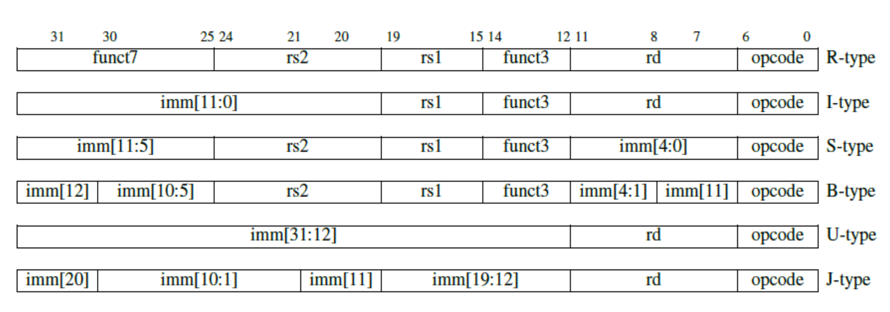
RISC-V指令
Register
Immediate
Store
Branch
Upper Immediate
Jump

Slide 4
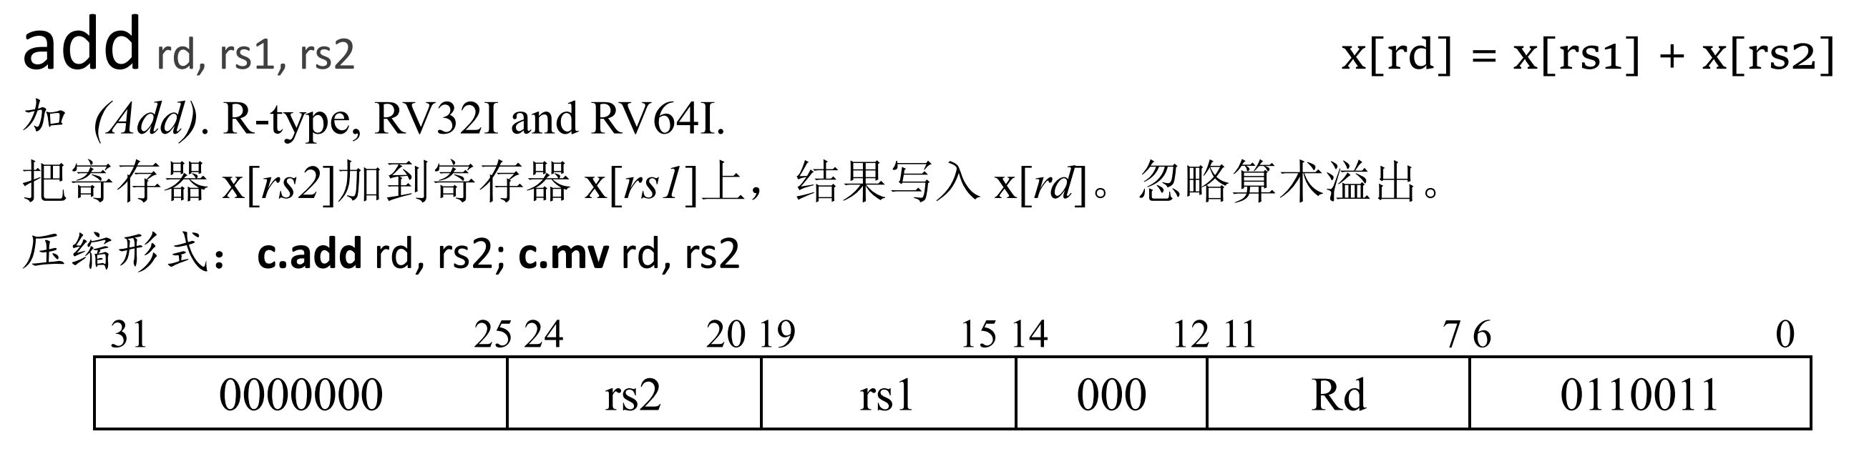
R-type
ASel = 0；BSel = 0；ALUSel = 0；WBSel = 1； RegWEn = 1;

Slide 5
Implementing R-Types
+4
pc
IMEM
Control

Slide 6
Implementing R-Types
+4
pc
IMEM
inst[11:7]
inst[19:15]
inst[24:20]
Control

Slide 7
Implementing R-Types
+4
Reg[]
pc
IMEM
inst[11:7]
AddrD
R[rs1]
inst[19:15]
AddrA
DataA
inst[24:20]
R[rs2]
AddrB
DataB
Control

Slide 8
Implementing R-Types
+4
Reg[]
pc
IMEM
inst[11:7]
AddrD
ALU
R[rs1]
inst[19:15]
AddrA
DataA
inst[24:20]
R[rs2]
AddrB
DataB
inst[31:0]
Control
ALUSel

Slide 9
Implementing R-Types
+4
Reg[]
pc
wb
DataD
IMEM
inst[11:7]
AddrD
ALU
R[rs1]
inst[19:15]
AddrA
DataA
inst[24:20]
R[rs2]
AddrB
DataB
inst[31:0]
Control
ALUSel

Slide 10
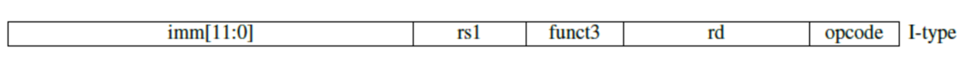
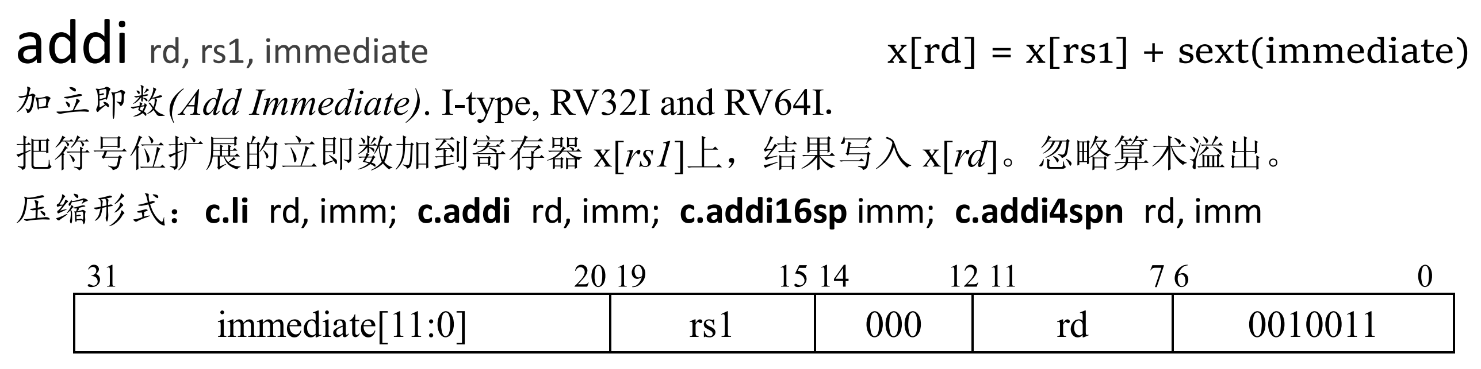
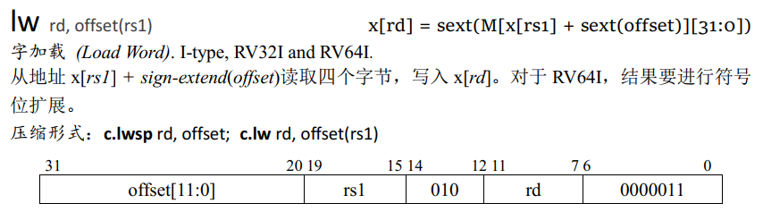
I-type
Asel = 0；BSel = 1；ImmSel = 0; ALUSel = 0；WBSel = 1；RegWEn = 1;

Slide 11
Implementing arithmetic I-Types
+4
Reg[]
pc
wb
DataD
IMEM
inst[11:7]
AddrD
R[rs1]
ALU
inst[19:15]
AddrA
DataA
inst[24:20]
R[rs2]
AddrB
DataB
inst[31:0]
inst[31:20]
Imm.
Gen
Control
ImmSel
ALUSel

Slide 12
Implementing arithmetic I-Types
+4
Reg[]
pc
wb
DataD
IMEM
inst[11:7]
AddrD
R[rs1]
ALU
inst[19:15]
AddrA
DataA
inst[24:20]
R[rs2]
0
AddrB
DataB
1
inst[31:0]
inst[31:20]
Imm.
Gen
imm[31:0]
Control
ImmSel
ALUSel
BSel=1

Slide 13
Adding lw to datapath
+4
Reg[]
ALU
pc
wb
DataD
ALU
1
DMEM
IMEM
inst[11:7]
AddrD
Reg[rs1]
pc+4
Addr
DataR
wb
inst[19:15]
AddrA
DataA
0
0
Reg[rs2]
mem
inst[24:20]
AddrB
DataB
1
inst[31:20]
Imm.
Gen
imm[31:0]
inst[31:0]
ImmSel
BSel
ALUSel
MemRW
WBSel

Slide 14
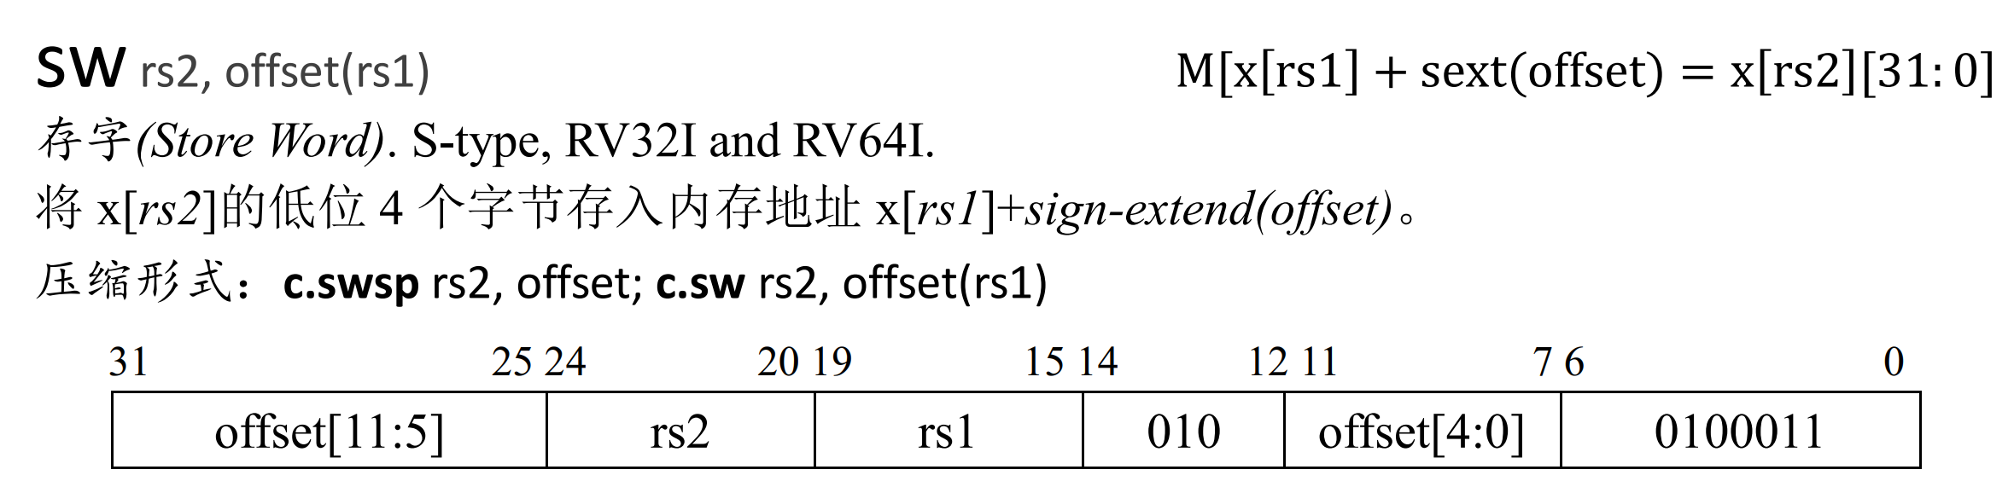
S-type

Slide 15
Adding sw to datapath
+4
Reg[]
ALU
pc
wb
DataD
Reg[rs1]
ALU
1
DMEM
IMEM
inst[11:7]
AddrD
Addr
pc+4
Reg[rs2]
DataR
wb
inst[19:15]
AddrA
DataA
0
0
DataW
mem
inst[24:20]
AddrB
DataB
1
inst[31:7]
Imm.
Gen
imm[31:0]
inst[31:0]
ImmSel
RegWEn
Bsel
ALUSel
MemRW
WBSel

Slide 16
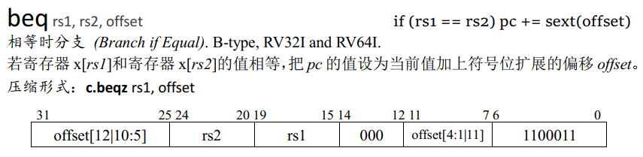
B-type

Slide 17
Adding branches to datapath
+4
Reg[]
ALU
pc
wb
Reg[rs1]
DataD
ALU
pc+4
DMEM
IMEM
inst[11:7]
AddrD
Addr
1
Branch Comp.
Reg[rs2]
DataR
wb
inst[19:15]
AddrA
DataA
0
0
DataW
mem
inst[24:20]
AddrB
DataB
1
inst[31:7]
Imm.
Gen
imm[31:0]
inst[31:0]
ImmSel
RegWEn
BrUn
BrEq
BrLT
BSel
ALUSel
MemRW
WBSel

Slide 18
Adding branches to datapath
+4
Reg[]
pc
ALU
pc
wb
1
1
DataD
Reg[rs1]
ALU
alu
0
DMEM
0
IMEM
inst[11:7]
AddrD
Addr
1
pc+4
Branch Comp.
Reg[rs2]
DataR
wb
inst[19:15]
AddrA
DataA
0
0
DataW
mem
inst[24:20]
AddrB
DataB
1
inst[31:7]
Imm.
Gen
imm[31:0]
PCSel
inst[31:0]
ImmSel
RegWEn
BrUn
BrEq
BrLT
BSel
ASel
ALUSel
MemRW
WBSel

Slide 19
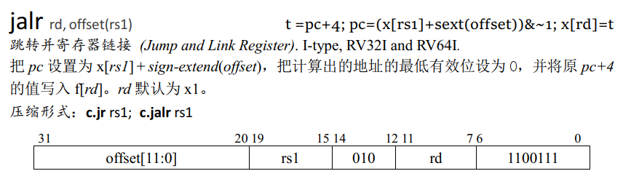
J-type

Slide 20
Adding jalr to datapath
+4
Reg[]
pc
pc+4
pc
wb
1
alu
1
DataD
Reg[rs1]
ALU
2
alu
0
DMEM
0
IMEM
inst[11:7]
AddrD
Addr
1
pc+4
Branch Comp.
Reg[rs2]
DataR
wb
inst[19:15]
AddrA
DataA
0
0
DataW
mem
inst[24:20]
AddrB
DataB
1
inst[31:7]
Imm.
Gen
imm[31:0]
PCSel
inst[31:0]
ImmSel
RegWEn
BrUn
BrEq
BrLT
BSel
ASel
ALUSel
MemRW
WBSel

Slide 21
Single-Cycle RISC-V RV32I Datapath
+4
Reg[]
pc
pc+4
pc
wb
1
alu
1
DataD
Reg[rs1]
ALU
2
alu
0
DMEM
0
IMEM
inst[11:7]
AddrD
Addr
1
pc+4
Branch Comp.
Reg[rs2]
DataR
wb
inst[19:15]
AddrA
DataA
0
0
DataW
mem
inst[24:20]
AddrB
DataB
1
inst[31:7]
Imm.
Gen
imm[31:0]
PCSel
inst[31:0]
ImmSel
RegWEn
BrUn
BrEq
BrLT
BSel
ASel
ALUSel
MemRW
WBSel

Slide 22
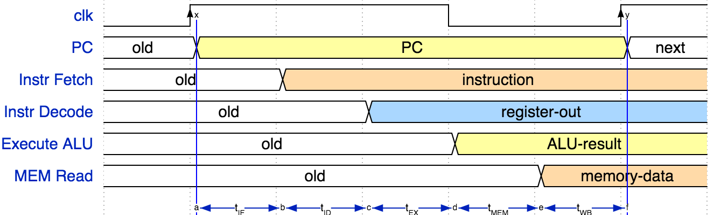
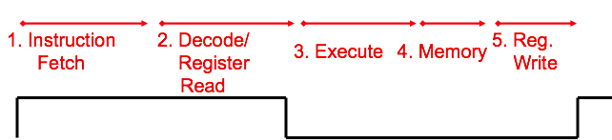
单周期CPU时序
IF | ID | EX | MEM | WB | Total
IMEM | Reg Read | ALU | DMEM | Reg W
200 ps | 100 ps | 200 ps | 200 ps | 100 ps | 800 ps

Slide 23
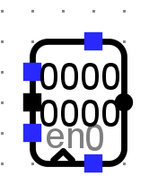
寄存器
Preset (when 1, pin value to max asynchronously)
Chip Select (1 disables component)
Data output (can be various bit widths)
Data input (can be various bit widths)
Write Enable (can it be written to)
Clock input (inputs active only on a clock “tick”)
Reset (sets value to zero)

Slide 24
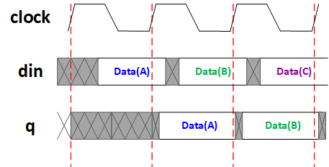
D触发器时序

Slide 25
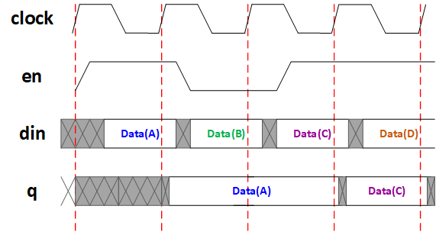
带使能端D触发器时序

Slide 26
Pipelining RISC-V RV32I Datapath
+4
Reg[]
pc
pc+4
pc
wb
1
alu
1
DataD
Reg[rs1]
ALU
2
alu
0
DMEM
0
IMEM
inst[11:7]
AddrD
Addr
1
pc+4
Branch Comp.
Reg[rs2]
DataR
wb
inst[19:15]
AddrA
DataA
0
0
DataW
mem
inst[24:20]
AddrB
DataB
1
inst[31:7]
Imm.
Gen
imm[31:0]
Instruction Fetch
(F)
Instruction Decode/Register Read
(D)
ALU Execute
(X)
Memory Access
(M)
Write Back
(W)
NOTE: Control signals are also pipelined!

Slide 27
Pipelined RISC-V RV32I Datapath
Recalculate PC+4 in M stage to avoid sending both PC and PC+4 down pipeline
pc_{X}
pc_{M}
pc_{F}
pc_{D}
+4
+4
Reg[]
rs1_{X}
1
DataD
ALU
alu_{X}
DMEM
0
AddrD
alu_{M}
Addr
pc_{F}+4
IMEM
Branch Comp.
DataR
AddrA
DataA
DataW
DataB
AddrB
inst_{D}
rs2_{X}
rs2_{M}
imm_{X}
Imm.
inst_{X}
inst_{M}
inst_{W}
Must pipeline instruction along with data, so control operates correctly in each stage

Slide 28
Each stage operates on different instruction
lw t0, 8(t3)
sw t0, 4(t3)
slt t6, t0, t3
or t3, t4, t5
add t0, t1, t2
pc_{X}
pc_{M}
pc_{F}
pc_{D}
+4
+4
Reg[]
rs1_{X}
1
DataD
ALU
alu_{X}
DMEM
0
AddrD
alu_{M}
Addr
pc_{F}+4
IMEM
Branch Comp.
DataR
AddrA
DataA
DataW
DataB
AddrB
inst_{D}
rs2_{X}
rs2_{M}
imm_{X}
Imm.
inst_{X}
inst_{M}
inst_{W}
Pipeline registers separate stages, hold data for each instruction in flight

Slide 29
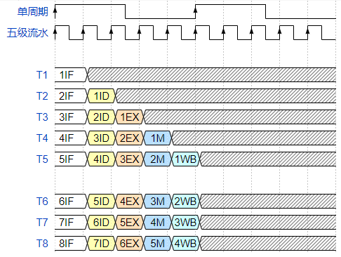
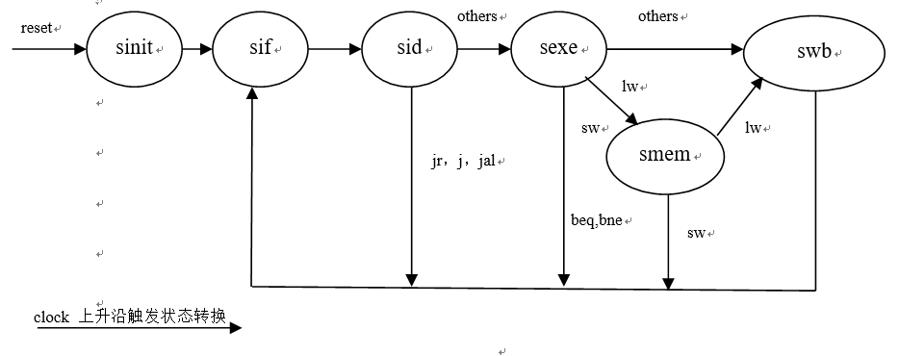
流水与多周期（状态机）
流水：以面积换性能，以空间换时间
VS
状态机：以性能换面积，以时间换空间
状态机，需要多个时钟周期才能完成一条指令的所有操作，每个时钟周期完成状态机的一个状态（分别为取值、译码、执行、访存和写回）。通过使用状态机，可以省略上述流水中的寄存器开销，还可以复用组合逻辑数据通路，因此面积开销比较小，但是每条指令都需要5个周期才能完成，吞吐量和性能很差。（早期原始的8051单片机）

Slide 30
实验一：RISC-V三段流水仿真

Slide 31
实验目的
Part A
理解流水线基本概念，掌握三段理想流水线RISC-V CPU工作流程
Part B
理解控制冒险的基本原理，掌握控制冲突流水线处理流程

Slide 32
实验原理 — 流水线的相关冲突（hazard）
资源相关
取操作数与取指令都需要访问主存
多周期方案中计算PC、分支地址，运算指令 复用ALU
增加部件消除
寄存器组先写后读
分支相关
控制IF段进行分支跳转
提前取出指令作废，流水线清空
数据相关
指令操作数依赖于前一条指令的执行结果
引起流水线停顿直到数据写回

Slide 33
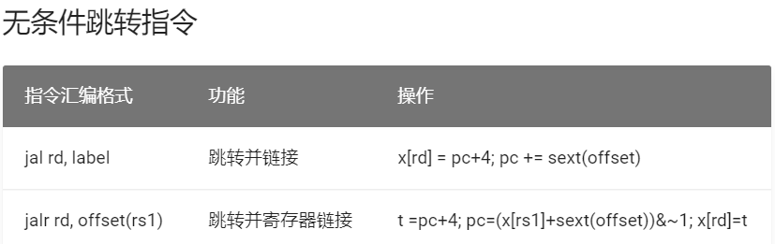
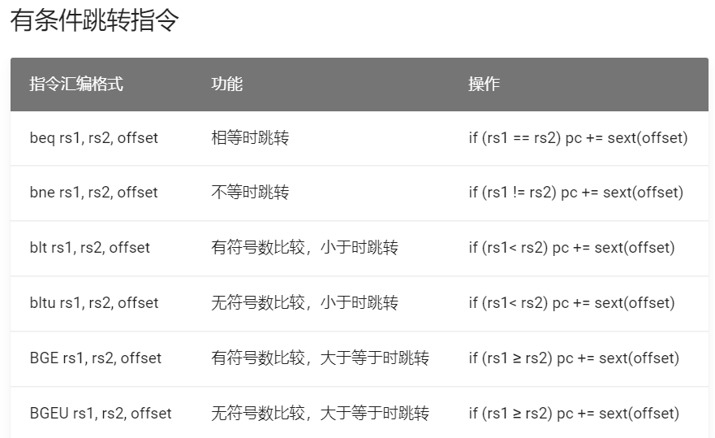
实验原理— 分支指令

Slide 34
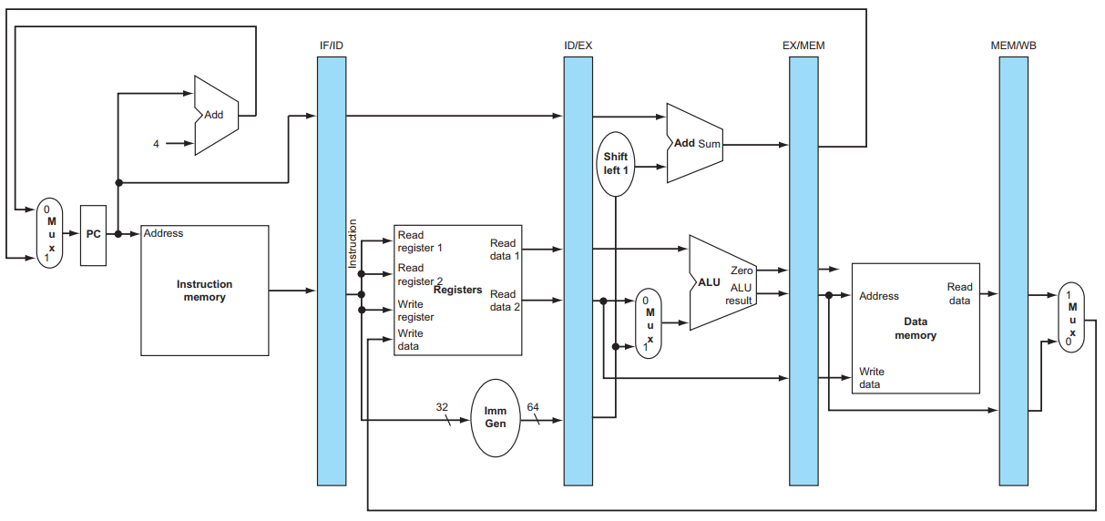
实验原理 — 分支相关
预取指令
预取指令
sub x3,x1,x2
add x3,x1,x2
beq zero, zero, 0010
#分支相关测试程序
beq zero, zero, 0010
add x3,x1,x2
sub x3,x1,x2
预取指令
插入气泡

Slide 35
实验原理 — 分支相关
清空预取指令
清空预取指令
正确指令
nop
nop
beq zero, zero, 0010
预取指令

Slide 36
实验原理——分支相关时空图
IF
ID
EX
M
WB
空间
1
1
2j | 1
3 | 2j | 1
4 | 3 | 2j | 1
10 | 气泡 | 气泡 | 2j | 1
11 | 10 | 气泡 | 气泡 | 2j
2
指令2为跳转指令
3
4
5
清空误取指令，取正确指令10
6
时间

Slide 37
实验步骤
修改流水接口部件，使其能实现同步清零插入气泡的功能。即在流水接口部件中，增加多路选择器，由多路选择器决定寄存器的输入：本段处理完成的数据或清零信号。
加载分支相关测试程序进行功能调试，该程序包含有无条件跳转指令和有条件跳转指令，使其能在流水线上正确运行。

Slide 38
关于halt停机判断
需要把instruction传递到第三级流水，同时判断第一级流水和第三级流水的instruction是否都0，如果是，则给出halt信号，停止计数。

Slide 39
实验提交
时间截点
三个星期内，即6月9日之前提交，否则视为未提交
需提交的内容
电路文件
运行结果截图
把设计思路写到实验报告中，实验报告格式不限
提交邮箱：hitsz_arch2020@163.com

